Slide 2
Introduction to modern R data analysis
Christopher Cameron
Computational Scientist
Cornell University Center for Advanced Computing
https://cac.cornell.edu/Cameron/
cjc73@cornell.edu

Slide 3
Questions
What is R and how does it fit in the statistical analysis and data science ecosystems?
When is R a good choice for data analysis?
What features make R useful for researchers?
Where can I get more information?
R takes time to learn, and this is the first step. The materials and demonstrations today will help you decide if R is worth the investment.

Slide 4
Agenda
Orientation to the R ecosystem
Why R?
Motivation for R
Brief history of R
What is R?
Community
Documentation and help
Introduction to R software
R Console
RStudio
“10 minutes to R”
R Essentials via R Notebook
Data Analysis Examples
Grammar of graphics and data

Slide 5
R is…
Good for:
Less suitable for
tabular data (or vectors or lists)
statistical analysis
data visualization
Integrating custom code in C/C++, Fortran and Java.
unstructured data
file system scripting
data scraping, cleaning and formatting
Some people want R to do everything, so packages do exist to make some of these possible!
(Someone also wrote a web-crawler in SAS)

Slide 6
R, Python, and Julia
Trio of modern open-source computer languages favored by data scientists.
Jupyter Lab stands for the Julia, Python, and R languages
R and Python have significant overlap and similarity, but
Python is more general
Python tends to be favored for deep learning
R and Python are both popular in machine learning
R tends to be favored for statistical analysis
Both have huge communities and many add-on packages
Julia is general purpose language designed at MIT with numerical computing in mind.
Only recently reached version 1.0
Designed to be more performant but it is still developing
Small ecosystem compared to R and Python (but can use R and Python)
Keep an eye on it!

Slide 7
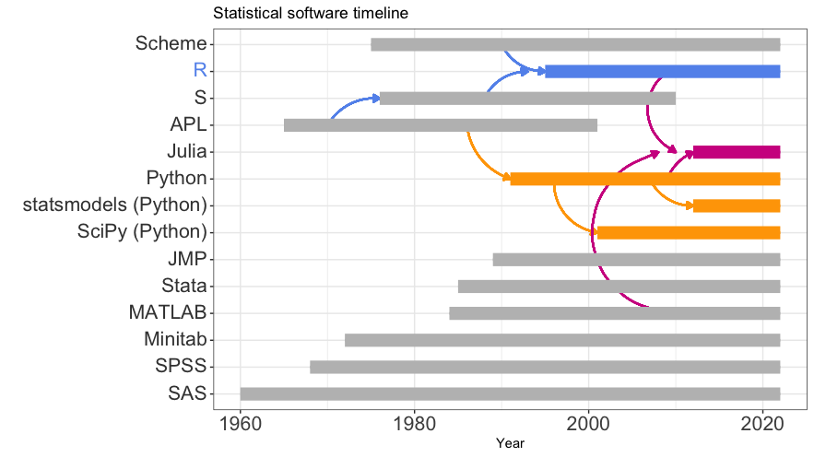
Statistics Software Ecosystem
R is a relative newcomer (as is Python),
but builds on a long legacy (APL, S, Scheme).

Slide 8
Motivation for R
What if we combine things we like into a statistical computing environment and make it free and open source so others could do the same?
Two faculty members at the University of Auckland wanted a “better software environment [for] their teaching laboratory” (1990s)
did not like the commercial offerings available
did like the S statistical programming language
wished S had some of the modern language features introduced in the Lisp variant called Scheme
R started as an S implementation with some Scheme features and was distributed via an email list
A colleague persuaded the authors to open-source R (1995)
Ihaka, Ross. (1998) R : Past and Future History, A Draft of a Paper for Interface ’98. https://cran.r-project.org/doc/html/interface98-paper/paper.html

Slide 9
Collective, eclectic development
R’s developers borrow code conventions and programming styles freely.
“object oriented” object.member naming is common but has no special meaning in R
Many conventions mixed together: InitalCaps, camelCase, snake_case, vars.with.dots (again, R does not assign special meaning)
Packages tend to work well with expected input and unpredictably with incorrect input.
Many ways to accomplish any given task, inspired by different paradigms.
Focus on practical, productive use
automatic and silent type conversion (casting)
convenience features can become gotchas (global namespace, attach)
packages can mask each other’s functions
variable names can have the same name as functions – mostly works, hard to read

Slide 10
Community
R is used and supported by a community of largely academic researchers and developers (and more recently, data scientists).
R gains new features via packages developed by the community
Over 10,000 add-on libraries!
R packages can target highly specialized research areas.
R packages are used to implement and share cutting edge statistical methodology.
The official package collection is at https://cran.r-project.org
Other collections exist: http://www.bioconductor.org.
Can load packages directly from github
Active community generating tutorials and demos:
https://www.r-bloggers.com
https://education.rstudio.com/learn/
https://cvw.cac.cornell.edu/R/
https://community.rstudio.com ← community help forum

Slide 11
Documentation
R has built-in help and documentation
A typical help entry includes
Descriptions of each function and their arguments.
Examples showing how the functions might be used.
References to relevant manuals and academic papers.
Documentation for packages usually also includes:
One or more vignettes demonstrating how the package can be used to perform an analysis.
Bundled data sets that support the vignette and demonstrate required data formats.

Slide 12
Base R
The R Project for Statistical Computing is maintained by The R Foundation.
free and runs on Linux, Windows and MacOS.
https://www.r-project.org
Command line interface via R console
Creates objects in memory rather than printing to screen
You query and manipulate these in-memory objects
Interactive, but not in the point-and-click GUI sense.
Many people that “use R” do not use it directly. Instead, they use something that interfaces with the R environment.
RStudio IDE
Jupyter Lab notebooks
Google CoLab

Slide 13
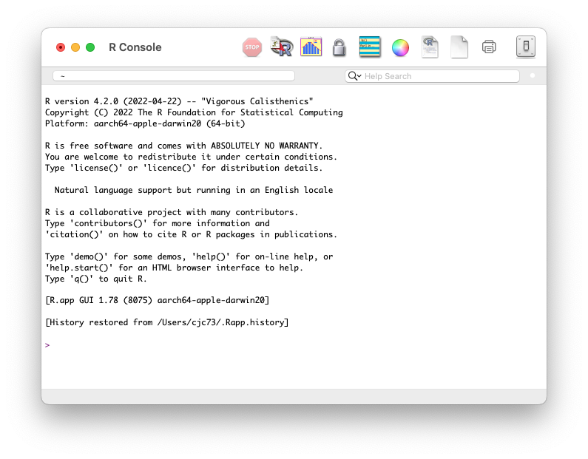
R Console

Slide 14
RStudio
RStudio is an integrated development environment for R
developed by RStudio Public Benefit Corporation (now Posit)
depends on installed R version
adds useful development, analysis and authoring features
RStudio interface incorporates the R Console
Posit will incorporate Python compatibility
Tip: If you want to install RStudio locally, install R and then install RStudio
RStudio Cloud (soon to be Posit Cloud) https://rstudio.cloud is a hosted version of RStudio with the same interface as the desktop application.

Slide 15
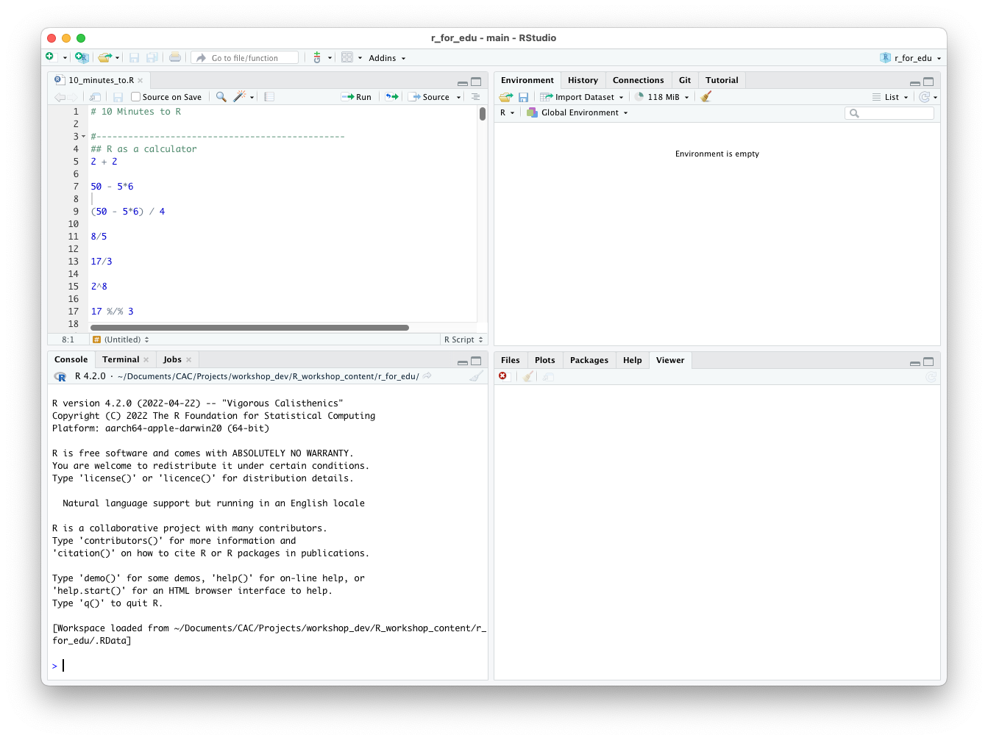
RStudio Interface

Slide 16
More information
Cornell Virtual Workshop in R: https://cvw.cac.cornell.edu/R/
CVW offers free self-paced, text-based modules covering a variety of computational focused topics. The CVW R topic complements today’s workshop and covers using R on multiple cores and on supercomputer infrastructure.
RStudio Cheatsheets:
https://www.rstudio.com/resources/cheatsheets/
Thoughtfully designed, single-page, double-sided reference sheets for major R packages.

Slide 17
More information
Using R for teaching and research:
https://www.chrisbail.net/teaching
Chris Bail’s work is a good example of incorporating R into teaching and research at undergraduate and graduate levels. Dr. Bail uses R for most aspects of his data collection and analysis.
eBooks:
R for Data Science, Hadley Wickam and Garrett Grolemund - https://r4ds.had.co.nz
Advanced R (Programming), Hadley Wickam - https://adv-r.hadley.nz

Slide 18
More information
Installing R for Jupyter Notebooks:
If you already use Jupyter, you can install the R jupyter kernel to use R in the familiar notebook environment. If you are on macOS, read the yellow warning box on the linked page. https://irkernel.github.io/installation/
R packages on CRAN by area:
https://cran.r-project.org/web/views/

